Slide 1

HiddenWalls (Review – 3)
by
KAUSTUBH JHA
18BCE1043
YASH DEKATE
18BCE1307
ADITYA PRASAD
18BCE1047

Slide 2
Problem Statement & Goal
The problem is that attackers always study the systems that they’re planning to attack on. As a result, during executing the attack, they already know all the weak points of the system and where all the security mechanisms are planted and when they come into action. As a result, they have high chances of being successful in carrying out their attacks rendering the target system helpless as it can do nothing but suffer the consequences.
The goal of our project would be to introduce an additional custom configurable layer of security in the system which would always be hidden so that the attacker won’t be able to study it during reconnaissance. During the attack, this hidden layer would come to surface and will surely tend to disrupt the malicious plans of the attacker. Hence, we’re trying to improve the security at endpoints.

Slide 3
Proposed Solution
The proposed solution is to create a CLI tool to create custom ‘Hidden Walls’ which are essentially hidden Linux Kernel Module with custom configurations. This CLI tool behaves as a custom Linux Kernel Module generator.
This tool would basically introduce an additional layer of security in the kernel of the operating system by using a combination of netfilers and iptables as described in the paper listed on the previous slide.
This additional module will be hooked to the kernel.
If possible, we may even try to implement these on distributed systems.

Slide 4
Modules
Configuration Module
This is where we mention our ‘firewall’ configuration that we want to specify for our system. Here we include public ports (ports visible to any machine), whitelisted machine IP addresses (machines that are trusted by us to be non threatening) and the ports to which the whitelisted machines can connect to.
We can also mention our unique ‘hide’ and ‘unhide’ keys that are known only to us. This is needed when we have to hide or unhide the module inserted in the kernel.
Since the kernel module is hidden by default, we would need to unhide it using the unhide key in order to overwrite or remove it. If we unhide it for some reason, we can hide it back without having to remake the modules again. We can simply use the ‘hide’ key.

Slide 5
Modules (Contd …)
Templates Module
This file is used to carry out the core functionality of hiding the kernel module and deciding which packets are accepted/dropped at which port based on predefined parameters in the configuration file. It does this with the help of netfilter hooking.
The unique thing about HiddenWalls is the flexibility it offers you and this is the module responsible for it. We can write many types of templates depending upon the type of firewall functionality we desire and we can invoke them as per the rules defined in the hiddenwall configuration file.
Parser Module
This module is used to generate the CLI and make it a complete command line utility tool. It takes in the configuration file to use along with the template file according to the functionality desired.

Slide 6
Methodology
The configuration rules are created, stored and then transferred to the template file where the functions have been defined using the rules as parameters to hide/unhide the module. It is also defined when to accept or drop packets and from which port(s).
The template file generates an output .c file called with the configurations processed using specialized functions.
We then switch to the directory of these output .c files and ‘make’ the object (.o) and kernel object (.ko) fileas per the commands in the Makefile in this directory.
We then insert the module in the kernel using insmod. This module is hidden by default and can’t even be seen by the root user unless they know the key to unhide it.

Slide 7
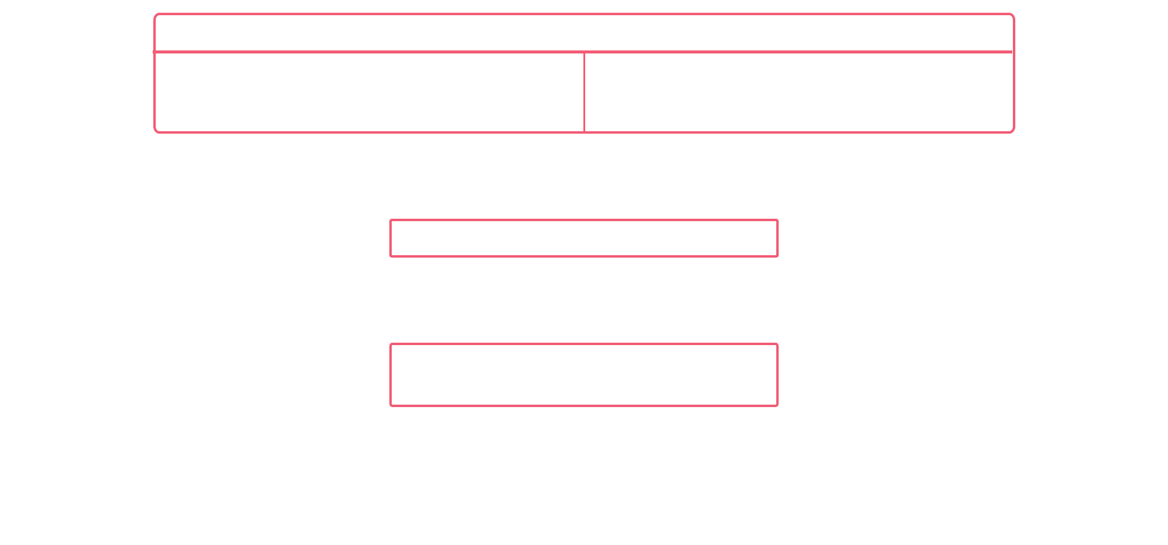
Flow Diagram

Slide 8
Software Requirements
Programming Languages Needed
Python for CLI functionalities.
C for Linux configurations and making templates.
Serialization Languages Needed
YAML for configuring custom firewall rules.
Operating Systems & Kernel Knowledge Needed
Linux and its Kernel in VM Environments for implementing hidden modules and testing those.

Slide 9
Code Snippets
Configuration Module (server.yaml)
Firewall Rules Configuration
module_name: SandWall public_ports: 80,443,53 unhide_key: AbraKadabra hide_key: Shazam fake_device_name: usb14 liberate_in_2_out: True whitelist: - machine: ip: 192.168.1.22 open_ports: 22,21 - machine: ip: 192.168.1.18 open_ports: 22,21

Slide 10
Code Snippets
Configuration Module (server.yaml)
Firewall Rules Configuration
In the above file, we are basically setting up the basic configuration rules for the firewall.
We set up the module_name which is the name for the hidden firewall module, public_ports which are the ports that should be publicly visible to every machine, hide_key and unhide_key to hide/unhide our module and at last, the whitelist which are the IPs which are trusted by our machine to communicate with through specific ports only.

Slide 11
Code Snippets
Templates Module (hiddenwall.c)
Module Hiding/Unhiding
// This stores the IP addresses from whitelists static unsigned char *ip_address = "\x14\x00\x00\x03"; // This is the head pointer pointing to currently implemented module static struct list_head *module_previous; // This bit is to track hide/unhide status of current module static short module_hidden = 0; // List of public ports mentioned int whitelist[]={PUBLIC_PORTS}; void module_hide(void) { module_previous = THIS_MODULE->list; list_del(&THIS_MODULE->list); module_hidden = 1; } | ssize_t fake_write(struct file * filp) { memset(message,0,127); //key to unhide if(strstr(message,"UNHIDE_KEY")!=NULL) { list_add(&THIS_MODULE->list, module_previous); module_hidden = 0; } if(strstr(message,"HIDE_KEY")!=NULL) module_hide(); }

Slide 12
Code Snippets
Templates Module (hiddenwall.c)
Module Hiding/Unhiding
list.h provides a predefined mechanism in Linux to handle the kernel modules as a doubly linked list. When the kernel module is visible, it is because the THIS_MODULE pointer is pointing to it. The THIS_MODULE pointer is created automatically during kernel module initialization along with the struct.
It provides a struct as follows
struct list_head { struct list_head *next, *prev; };

Slide 13
Code Snippets
Templates Module (hiddenwall.c)
Module Hiding/Unhiding
The module_hide() function is called in init() at the beginning so that, to the user, the module is hidden by default.
The module_hide() method stores the module pointed to by THIS_MODULE . It stores the value pointed to by this pointer in a variable of type struct list_head. Then the currently pointed to module is deleted from the doubly linked list.
To unhide the module we simply add back the variable of type struct that holds the module.
All this is triggered when we enter the respective hiding/unhiding keys.

Slide 14
Code Snippets
Templates Module (hiddenwall.c)
Netfliter hooking and packet handling
unsigned int main_hook_v4(struct sk_buff *skb, const struct net_device *in, const struct net_device *out, int (*okfn)(struct sk_buff*)) { struct iphdr *ip_hdr = (skb!=0)?(struct iphdr *)skb_network_header(skb):0; unsigned int res=55; if(!skb) return NF_ACCEPT; if(!(ip_hdr)) return NF_ACCEPT; if(ip_hdr->protocol == IPPROTO_ICMP) res=test_icmp(skb); | if(ip_hdr->protocol == IPPROTO_UDP) res=test_udp(skb); if(ip_hdr->protocol == IPPROTO_TCP) res=test_tcp(skb); return NF_DROP; }

Slide 15
Code Snippets
Templates Module (hiddenwall.c)
Netfliter hooking and packet handling
test_icmp(struct sk_buff *skb) { struct icmphdr *icmph; struct iphdr *ip_hdr = (skb!=0)?(struct iphdr *)skb_network_header(skb):0; icmph = icmp_hdr(skb); if(!icmph) return NF_ACCEPT; if(ip_hdr->saddr == *(unsigned int*)ip_address) return NF_ACCEPT; if(icmph->type != ICMP_ECHOREPLY) return NF_DROP; }

Slide 16
Code Snippets
Templates Module (hiddenwall.c)
Netfliter hooking and packet handling
The concept behind accepting and dropping the packets is that we are using the struct sk_buffer which is a doubly linked list and it stores the header information for packets.
Based on the protocol, we call the respective function. In the function a struct (eg: icmphdr) is used to hold the header information. Using the header struct, we can check the parameters like ‘saddr’ and ‘type’ which are used to decide whether to accept or drop the packet.
If the source address is in the whitelist, the packet is accepted. Another case in which the packet is accepted is that if the packet is an echo reply.

Slide 17
Code Snippets
Templates Module (hiddenwall.c)
Public port acceptance
unsigned int test_tcp(struct sk_buff *skb) { int i=0; char daddr[16]; char saddr[16]; struct iphdr *ip_hdr = (skb!=0)?(struct iphdr *)skb_network_header(skb):0; struct tcphdr *tcph = tcp_hdr(skb); unsigned int dest_port = (unsigned int)ntohs(tcph->dest); unsigned int src_port = (unsigned int)ntohs(tcph->source); if(!tcph) return NF_ACCEPT; | snprintf(saddr,16,"%pI4",&ip_hdr->saddr); snprintf(daddr,16,"%pI4",&ip_hdr->saddr); while(i!=PORTS_COUNT) { if(dest_port == whitelist[i] || src_port == whitelist[i]) return NF_ACCEPT; i++; } return filter_port_scans(skb); }

Slide 18
Code Snippets
Templates Module (hiddenwall.c)
Public port acceptance
In the above code snippet we are simply accepting the packets at the public ports as specified in the configuration file.
In a nutshell, this simply means that we are accepting communication through these ports for the IPs which are whitelisted by us in the configuration file.

Slide 19
Code Snippets
Parser Module
Get and parsing user options
Wallgen.py # Get argvs of user's input template_filename, rules_filename = parser.arguments() # Load rules of firewall at directory rules try: rules_wall=parser.Get_config(rules_filename) except Exception as e: print(" log error in config parser rules: "+str(e)) exit(0) # Load templates and generate try: parser.start_generator(template_filename, rules_wall) except Exception as e: print(" log error in rule generator: "+str(e)) exit(0) | parser.py parser = argparse.ArgumentParser(description = banner()) parser.add_argument('-t', '--template', action = 'store', dest = 'template_filename', default="template/wall.c",required = False, help = 'Source code template at directory template’) parser.add_argument('-r', '--rules', action = 'store', dest = 'rules_filename', default="rules/server.yaml", required = True, help = 'Netfilter rules to create a kernel module, look directory rules’) args = parser.parse_args() < Peform file existence error handling>

Slide 20
Implementation – VMs
Virtual Machine (VM) Descriptions
Ubuntu with the IP 192.168.10.132 would server as our victim. It is on this machine that the whole HiddenWalls will be implemented. It is like implementing a hidden firewall which is invisible to the attacker.
Kali Linux with the IP 192.168.10.128 would serve as our attacker. It is through this machine that the attacker would try to attack the victim. Before attacking, it is a common practice to gather information and study the vulnerabilities. He would try to do this by a Nmap scan but eventually, won’t be able to gather much information due to the HiddenWall.

Slide 21
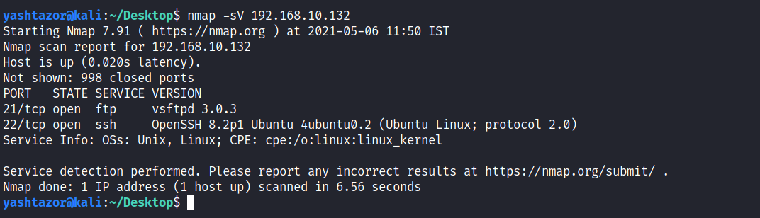
Implementation – Cases
Without Hiddenwall
This is an initial Nmap scan of our victim machine before applying any HiddenWall module to it.

Slide 22
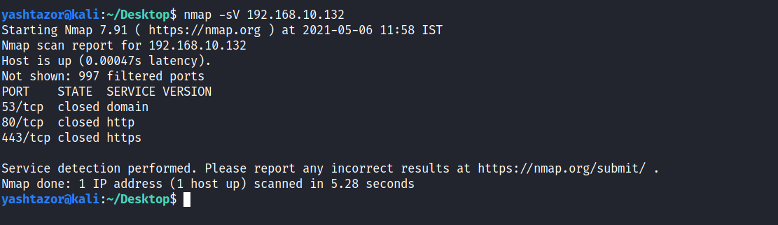
Implementation – Cases
IP Removed from Whitelist – Public Ports Remain Same
Here, we can see that the ports 21 and 22 are not visible as the attacker IP has been removed from whitelist.

Slide 23
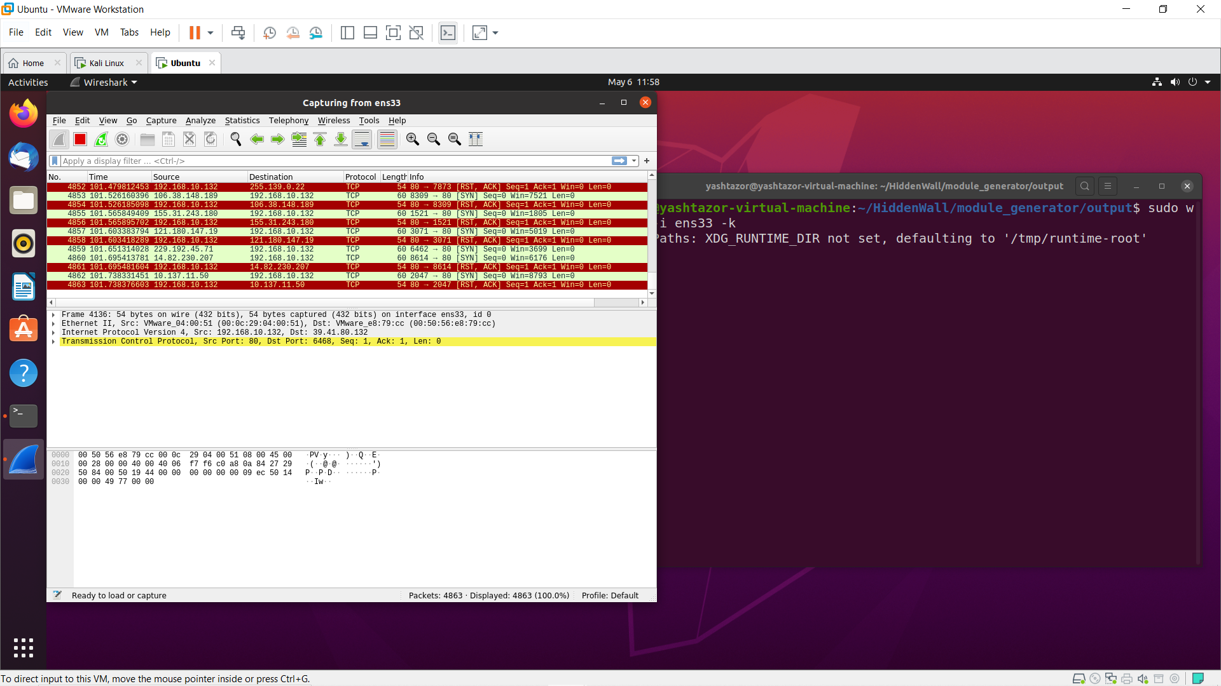
Implementation – Cases
IP Removed from Whitelist – Public Ports Remain Same – Wireshark Results
Packets are simply being RESET as 80 is a closed public port.

Slide 24
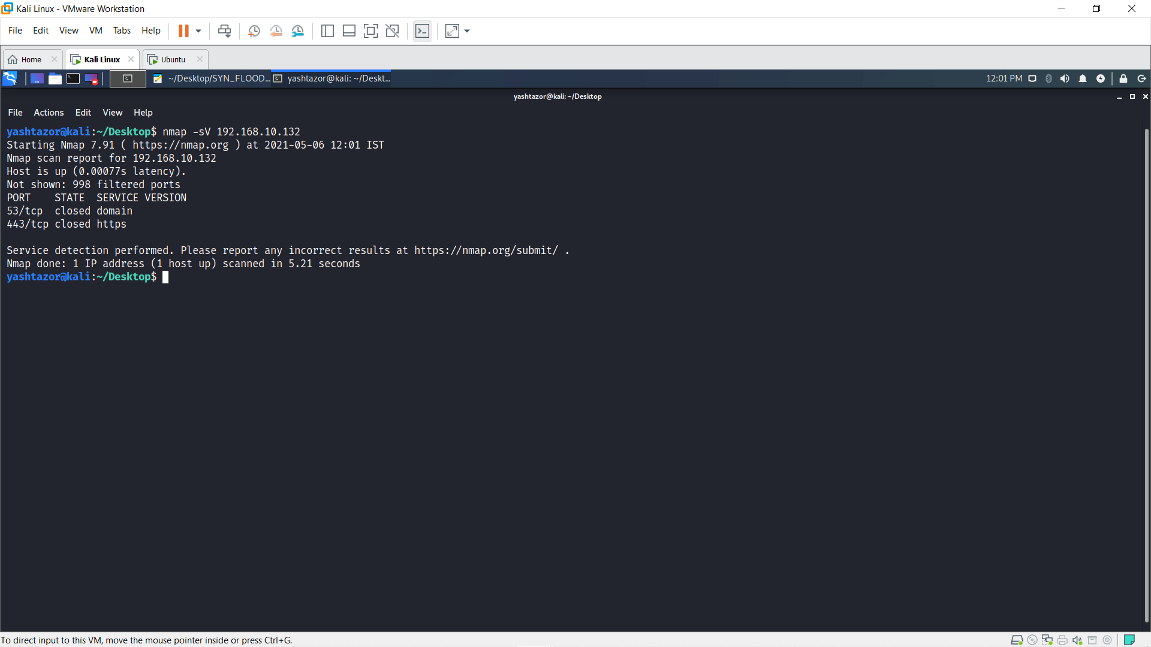
Implementation – Cases
IP Removed from Whitelist – 80 Removed from Public Ports
Here, we can see that the apart from ports 21 and 22, now even port 80 is also not shown as it has been removed from the public ports.

Slide 25
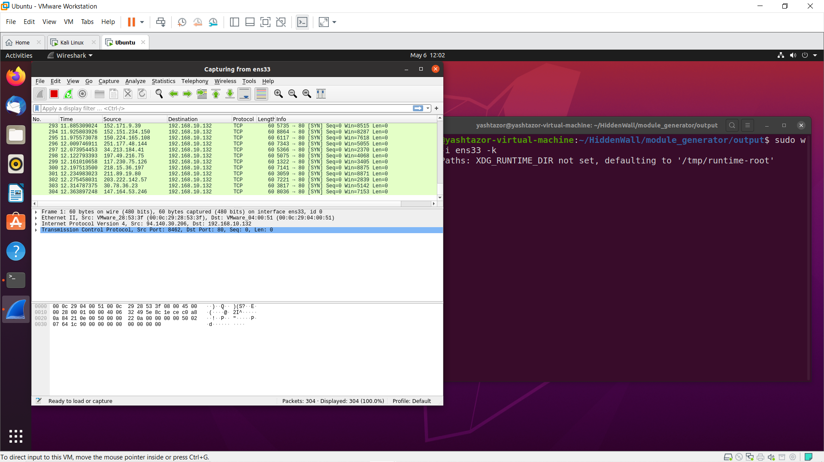
Implementation – Cases
IP Removed from Whitelist – 80 Removed from Public Ports – Wireshark Results
No ACK or RESET packets are shown as 80 is not a public port.

Slide 26

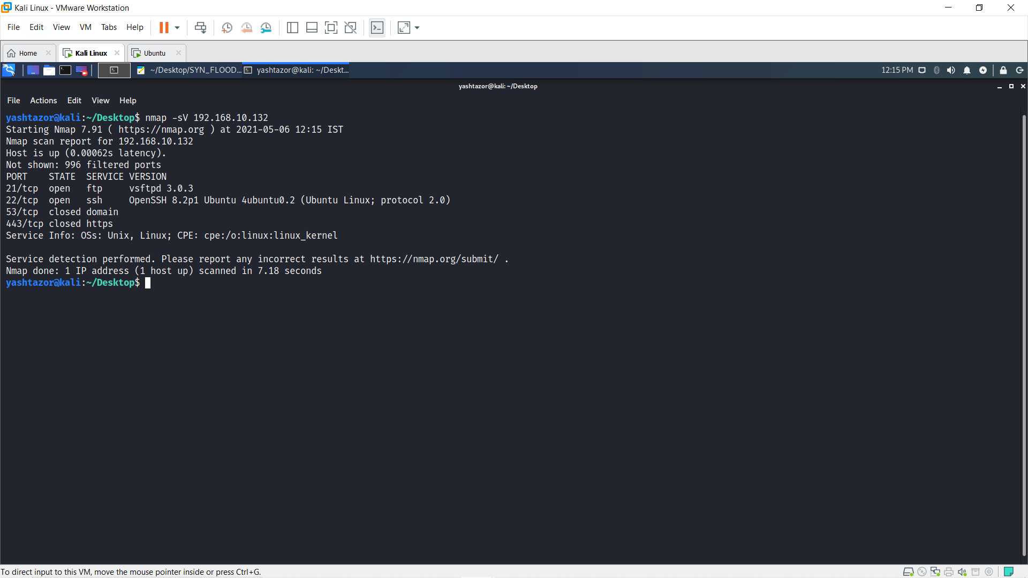
Implementation – Cases
IP Removed from Whitelist – 53 is a Closed Port
Here, we can see that all the public ports are visible and port 53 is closed. 21 and 22 are not seen as the IP has been removed from the whitelist.

Slide 27
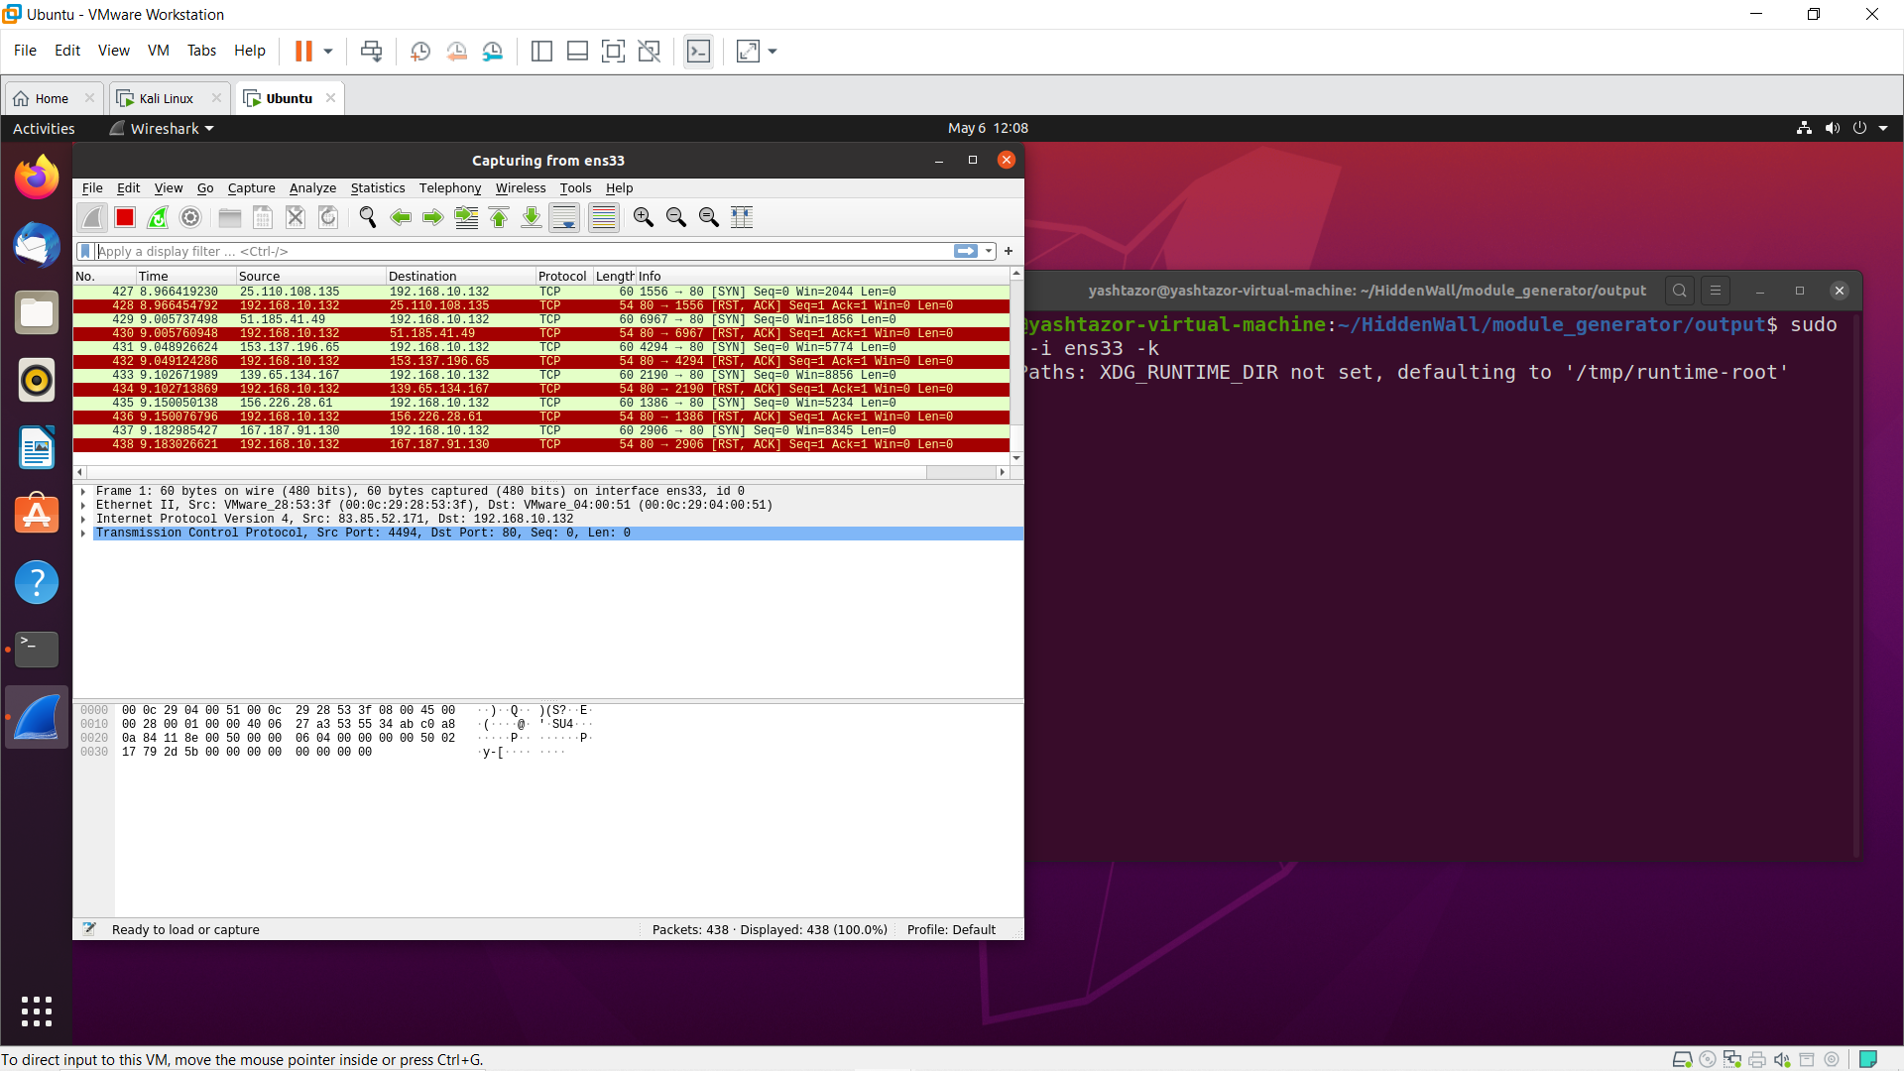

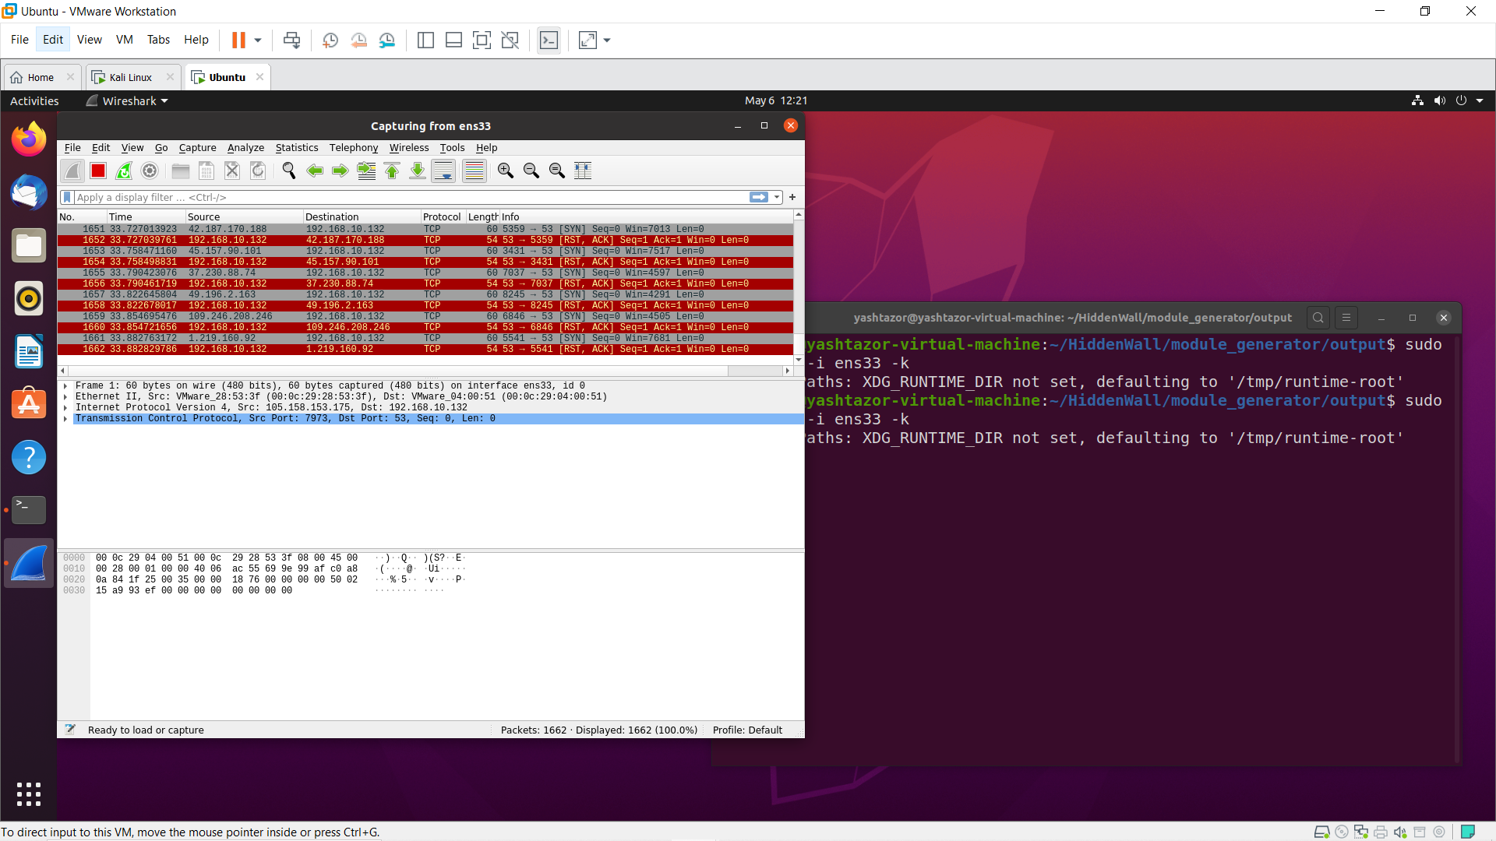
Implementation – Cases
IP Removed from Whitelist – 53 is a Closed Port – Wireshark Results
Connection is simply refused as 53 is a closed public port.

Slide 28
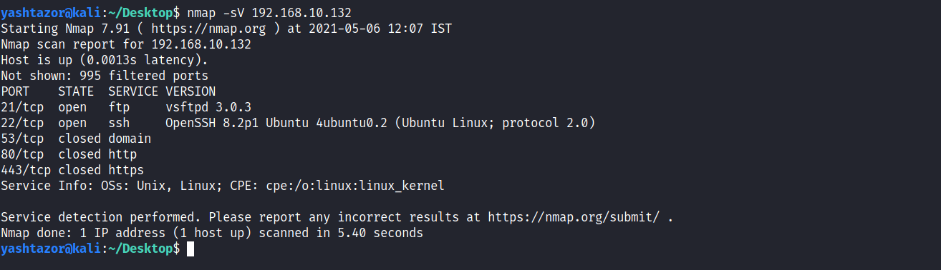
Implementation – Cases
IP in Whitelist – Public Ports Remain Same
Here, we can see that all the public ports as well as the ports 21 and 22 are visible as the IP is in whitelist.

Slide 29
Implementation – Cases
IP in Whitelist – Public Ports Remain Same – Wireshark Results
Packets are simply being RESET as 80 is a closed public port.

Slide 30
Implementation – Cases
IP in Whitelist – 80 Removed from Public Ports
Here, we can see that all the public ports except 80 as well as the ports 21 and 22 are visible as the IP is in whitelist.

Slide 31
Implementation – Cases
IP in Whitelist – 80 Removed from Public Ports – Wireshark Results
No ACK or RESET packets are shown as 80 is not a public port.

Slide 32

Implementation – Cases
IP in Whitelist – 22 is an Open Port
Here, we can see that all the public ports are visible and port 22 is open.

Slide 33
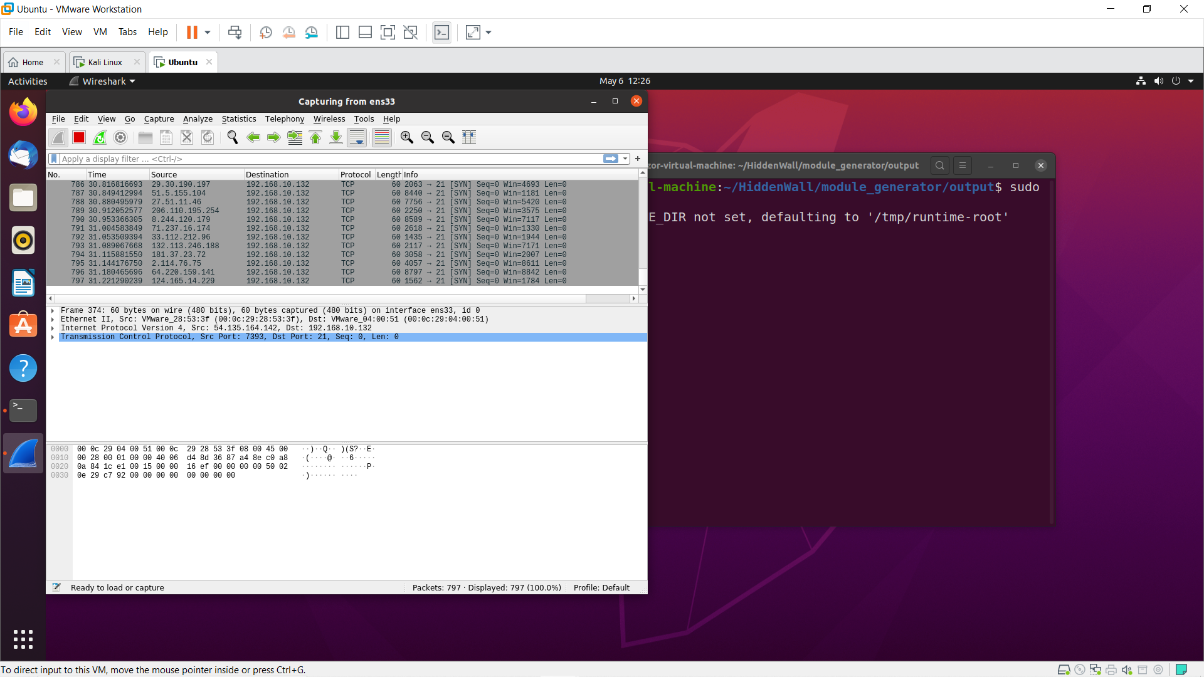
Implementation – Cases
IP in Whitelist – 22 is an Open Port – Wireshark Results
Connection is accepted as 22 is an open port of a whitelisted IP.

Slide 34
Demo Video
Please go to the below link to view the demo of our project.
https://drive.google.com/file/d/14YIpH7HOu69iUQy1T4pooXBkKO_ZnCFX/view?usp=sharing

Slide 35
Accuracy
The Hidden wall was successful in fending off different types of intrusion attacks.

Slide 36
Conclusion
In conclusion we feel a hidden wall is a great addition to the firewall, which is going to go undetected to different attacks. It provides an additional layer of security and secures the port number and keep is private.
It can be inserted easily and is not a very difficult module to include in modern day security systems.

Slide 37
Individual Contributions
Yash Dekate (18BCE1307)
SYN-FLOOD Attacking Script, Netfiler Hooking & Packet Handling and Public Port Acceptance in Hiddenwall.c and Sandwall.c construction.
Kaustubh Jha (18BCE1043)
Module Hiding/Unhiding and Netfilter Hooking & Packet Handling in Hiddenwall.c and Sandwall.c construction, and HiddenWalls Testing.
Aditya Prasad (18BCE1047)
Parser.py for the CLI tool, WallGen.py for rule and template files extraction, and Case Construction.

Slide 38
Progress Status
Review – 1
We proposed a project topic called HiddenWalls.
Review – 2
We have implemented the complete code for all the 3 modules involved in our project
Configuration Module (server.yaml) – 100 %
Templates Module (hiddenwall.c) – 100 %
Parser Module (Wallgen.py and parser.py) – 100 %
Review – 3
We implemented an attacking script to check the working of our Hiddenwall. To make it more robust, we also tested it under various cases which were constructed by us.

Slide 39
References
Our project is based on the following two research papers
1. Using Linux Kernel Modules for Operating Systems Class Projects by Timothy Bower
This paper talks about the various projects that can be carried out using the Linux Operating System. It classifies these projects into various categories out which, we decided to go with the category which involved ‘Modifying or adding on to the functionality of kernel modules’. Following that, it gives a short summary of what Linux Kernel Modules actually are and then goes on to describe some of the projects that can be done with them and it’s associated difficulties.
Link to the paper
https://bit.ly/3uDVjQ2

Slide 40
References (Contd…)
Our project is based on the following two research papers
2. The Research and Application of Firewall based on Netfilter by Qing-Xiu Wu
This paper talks about how the recent rapid development of computer networks and our reliance on it has made network security so important. It then talks about how security features of Linux have evolved over the years. The most important that has been pointed out is that netfilters and iptables in combination can be used as a firewall solution. Since both of these, viz., the netfilter and iptables are inbuilt to Linux, we decided to make a custom hidden security module out of those in the kernel.
Link to the paper
https://bit.ly/3q32fm4

Slide 41
Thank you!

